Slide 1
Visualization of Truck GPS Origin-Destination
Chi Ping Lam, Houston-Galveston Area Council

Slide 2
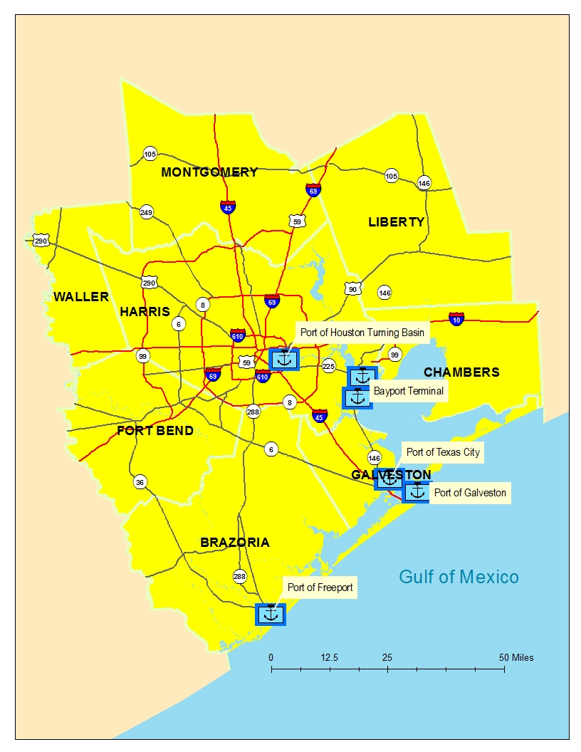
H-GAC Region
6.8 million population today, 10.7 million 2045
27,000 total road miles
185 million average weekday vehicle miles total

Slide 3
Freight System
465 million tons of goods shipped annually on road
4 deep water ports.
Port of Houston ranked first in foreign waterborne tonnage and second in total tonnage among US*
Petroleum products, crude oil, and chemicals makes up over 85% of all trade flow in region’s ports
3 major airports
*USACE Navigation Data Center

Slide 4
Background
H-GAC is developing a tour-based Truck Model
Purchased truck GPS data from third-party vendor
Cambridge Systematics is the consultant
The GPS raw data is confidential for model development
Consultant produces GPS data metrics
One metrics is origin and destination in TAZ level

Slide 5
Data Collected
Three truck classes
Heavy, Medium, Light
Heavy and medium truck data for April and October 2016
Light truck data from November 2015 to October 2016
Information
Location (Lat-long) of a stop
Time of a stop
Stop purpose implied by parcel land use
Disaggregated data and aggregation below TAZ level is confidential
Notes:
Long time frame on light trucks because light trucks have smaller sample size.

Slide 6
Truck Classification
Truck Model Classification | FHWA Classifiction | Description
Heavy | 8 to 13 | Large combination tractor trailers
Medium | 5 to 7 | Singe unit trucks
Light | 3 | Pickups, vans, and SUV with no more than 4 tires and less than 14,000 lbs
*Illustration Source: http://onlinemanuals.txdot.gov/txdotmanuals/tda/fhwa_vehicle_classification_figures.htm
Notes:
Bus are excluded.

Slide 7
Motivation of Visualization
Quick data quality check
Location makes sense?
Tells a visual story
Where are the trucks?
Perception vs data
Why on TAZ level?
TAZ level is not confidential

Slide 8
First question
Are the 3 classes of trucks have similar origins and destinations?
Answer: No
Notes:
If more trucks in TAZ, there are more dots in the TAZ. Visualization

Slide 9
Heavy vs Medium Truck Tour Origin
Notes:
First plots showing where individual truck tour starts.
Heavy trucks are more concentrated around a few activity centers while medium trucks spread around.

Slide 10
Light vs Medium Truck Tour Origin
Notes:
First plots showing where individual truck tour starts.
Heavy trucks are more concentrated around a few activity centers while medium trucks spread around.

Slide 11
Second Question
Could land-use explain the truck locations?
Compare truck locations to Land-Use map
Truck locations by color-scale and dot density

Slide 12
Truck Tour Origin by Land use
Retail, household, and warehouse are top 3 land use of truck locations
Industrial is #4
Over 30% Heavy truck are from outside of region (N/A)
Heavy trucks are much less likely go to residential land use, therefore least spread out

Slide 13
Heavy Trucks vs Parcel Level Land use
Notes:
Light yellow – residential; bright yellow – commercial; Red – industrial and warehouse; green – agriculture, park, open
The map on the right hand side is the parcel map colored by land use purpose
Heavy trucks tend to concentrate on industrial and warehouse (red color) , but there a few exceptions.
Modelers should also expect the TDM should forecast heavy around industrial plants and warehouse

Slide 14
Heavy Truck vs Land Use
Cluster on Industrial area (red color), especially Houston Ship Channel
A few near airports and seaports
Lightly spread to other land use
Black dot = 100 Heavy Trucks
Notes:
Blac

Slide 15
Medium Trucks vs Parcel Level Land use
Notes:
Medium Trucks are evenly spread. There are a few clusters, but doe not seem to concentrate on particular type of land use or area.

Slide 16
Medium Truck vs Land Use
Spread out
Denser on Industrial (red) and commercial (orange)
Decent number of trucks on residential land use
Black dot = 400 Medium Trucks
Notes:
Blac

Slide 17
Light Trucks vs Parcel Land use
Notes:
There are more light trucks on dense mixed-use area on West Houston and Medical Center. Also under airport

Slide 18
Light Truck vs Land Use
More light trucks on denser on mixed use area.
Some clusters on unexpected locations
Sampling size big enough?
Black dot = 400 Light Trucks
Notes:
Large Chemical Plants not major light ruck generators

Slide 19
Summary of trucks vs Parcel Land use
Heavy truck clusters on industrial land use
Medium truck are more spread out, albeit denser on industrial and commercial area
Some unexpected cluster for light truck.

Slide 20
Truck vs Employment
Land use does not indicate activity density. Employment does.
There are more employment classification than land use.
Truck model uses employment to calculate the size function (attractiveness) in tour generation model and destination choice model
Employments tell same stories as land use with a few more insights

Slide 21
How about ports?
Policymakers are very interested in regional cargo seaports and airports.
Are these ports major truck generators as claimed?

Slide 22
Port of Houston - Heavy Trucks
Barbours Cut is the largest container facility
It generates some heavy trucks, but not as much as some refinery and chemical plants nearby
Size of dot proportional to number of trucks in a TAZ
Notes:
The size

Slide 23
Port of Houston - Medium Trucks
The container port does not generate much medium trucks!
Size of dot proportional to number of trucks
Notes:
One question – In what degree Port generates truck Traffic?

Slide 24
IAH Airport- Heavy Trucks
IAH is the largest airport in Houston
Not generate heavy truck at all
Size of dot proportional to number of trucks
Notes:
One question – In what degree Port generates truck Traffic?

Slide 25
IAH Airport- Medium Trucks
IAH is the largest airport in Houston
Airport itself and nearby processing centers generated some medium trucks
Goods shipped by airport tends to be lower weight
Size of dot proportional to number of trucks
Notes:
One question – In what degree Port generates truck Traffic?

Slide 26
What the illustrations tell us about ports
Ports are decent truck generators, but not the biggest truck generators as some believed
Big chemical plants and oil refinery generators a lot more truck traffic, especially heavy trucks
Overall trucks at port are very small relative to regional truck traffic
Port is an important component, but not all, in freight planning

Slide 27
What the illustrations does not tell about port
Truck GPS are not commodity flow
It only show the first/last truck at port, but cannot trace the connecting freight truck/rail tour to transport the commodities to their final destination.
These illustrations cannot demonstrate the economic contributions of ports.

Slide 28
Outliner TAZ Case Study
There are some TAZs where employments are not good indicators of truck activities.
Truck activities could be very high or very low relatively to number of employments
The visualization could identifies causes of some outliners
Notes:
Not every outliners could be found with causes. For time being, here only show a few interesting examples

Slide 29
TAZ with many jobs and few trucks
58 TAZ with
Less than 30 heavy trucks
Less than 200 medium trucks
Over 1000 jobs
Mostly in CBD
Office and Education
Some of the office jobs with NACIS code “manufacturing” or “warehouse”
Headquarter issue
2 Exceptions
Notes:
There are some 58 TAZ has over 2000 manufacturing

Slide 30
Low Truck Example: USPS
USPS vehicle maintenance center in this TAZ
Unexpected low number of trucks
Observed on other delivery companies
Notes:
Low number of trucks also observed on UPS and Fedex centers

Slide 31
High Truck Example: Travel Center
Residential Area
There is a very large “Travel Center” for trucks
Travel centers also observed in other isolated heavy truck spots, but not every travel center is an isolated heavy truck spots.

Slide 32
High Truck TAZ: Subdivision Construction
21 job, around 2700 trucks
Possibly construction related vehicles
A very large new sub-division
Trucks activity vary on different “building” sub-divisions, probably depends on construction stage and size

Slide 33
Observations on Outliners
Some TAZ where employments are not good indicators of truck activities
Visualization could explains some causes of outliners:
Office centers generates less truck trips per employment
Delivery trucks not well captured
Special event centers, travel centers and construction sites generate many trucks without much employment
Employment database may locate some employments at headquarter than at actual work location
Illustration could not identify all causes of evert outliners

Slide 34
Bonus: External Truck Stop

Slide 35
Thank You!
Chi Ping Lam
Principal Data Analyst
Houston-Galveston Area Council
Email: Chi-ping.lam@h-gac.com

